Slide 1
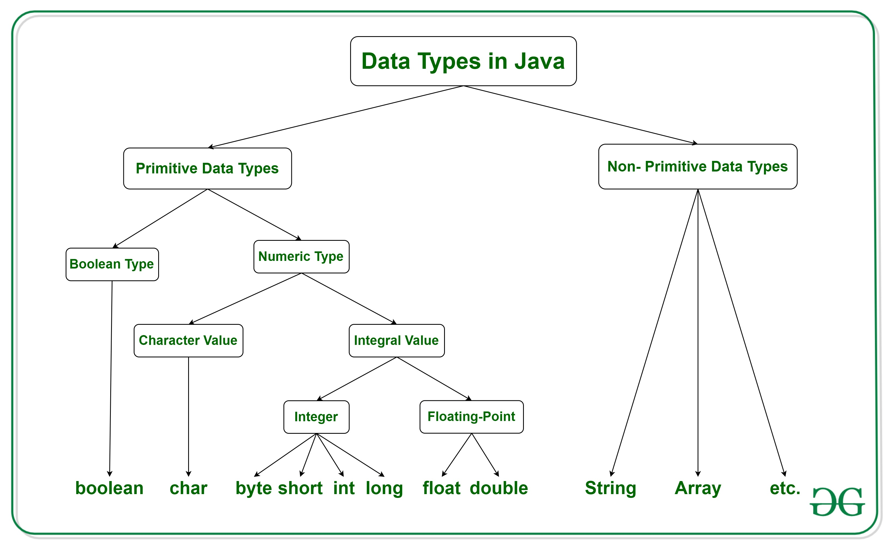
Data Type in Java

Slide 2
Java has two categories of data
Java has two categories of data:
Primitive Data Type: such as boolean, char, int, short, byte, long, float, and double
Non-Primitive Data Type or Object Data type: such as String, Array, etc.

Slide 3
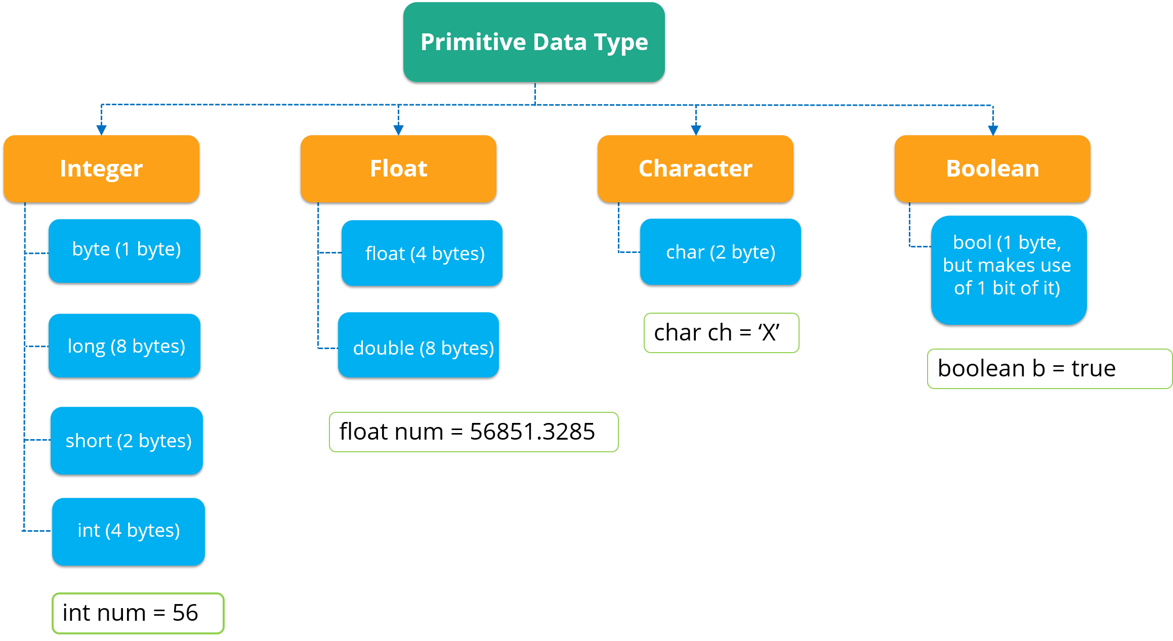

Slide 4
Boolean
1. boolean: boolean data type represents only one bit of information either true or false, but the size of the boolean data type is virtual machine-dependent. Values of type boolean are not converted implicitly or explicitly (with casts) to any other type. But the programmer can easily write conversion code.
Syntax:
boolean booleanVar;

Slide 5
e.g.
class Example{
public static void main(String args[])
{
boolean b = true;
if (b == true)
System.out.println("Hi Friend");
}
}

Slide 6
Byte
A byte is an Integer type that stores whole numbers ranging from -128 to 127, this clears the memory constraint problems if you are dealing with small numbers since it requires only 1 byte of memory.
Syntax:
byte byteVar;

Slide 7
e.g
class Example1{
public static void main(String args[])
{
byte a = 126 // byte is 8 bit value
System.out.println(a); //print 126
a++;
System.out.println(a); // print 127It overflows here because
// byte can hold values from -128 to 127
a++;
System.out.println(a); //-128 Looping back within the range
a++;
System.out.println(a); // -127
}
}

Slide 8
Short
A short is an Integer type that stores whole numbers ranging from -32768 to 32767, it consumes 2 bytes of memory from the disk. A short variable can be declared by using the “short” keyword. Assigning a value greater than 32767 to a short variable throws an “incompatible types” error.
Syntax:
short shortVar;
Size:
2 byte ( 16 bits )

Slide 9
int
4. An int is an integer type that stores whole numbers ranging from -2147483648 to 2147483647, it consumes 4 bytes of memory in the disk.
Syntax:
int intVar;
Size:
4 byte ( 32 bits )

Slide 10
long
Now, this is something interesting data type which consumes 8 bytes of memory in the disk. It is an integer type that stores whole numbers ranging from -9223372036854775808 to 9223372036854775807, phew that takes a considerable amount of time to read that range.
Syntax:
long longVar;
Size:
8 byte ( 64 bits )

Slide 11
float
Float is a floating-point data type, meaning that it can store the values including their decimal precision.
Syntax:
float floatVar;
Size:
4 byte ( 32 bits )
Values:
upto 7 decimal digits

Slide 12
double
Double is similar to float, but as the name says it is twice the float in the case of decimal precision.
Syntax:
double doubleVar;
Size:
8 byte ( 64 bits )
Values:

Slide 13
char
8. char: The char data type is a single 16-bit Unicode character.
Syntax:
char charVar;
Size:
2 byte ( 16 bits )

Slide 14
Non-Primitive Datatypes
Non-Primitive Datatypes
Non-Primitive data types refer to objects and hence they are called reference types. Examples of non-primitive types include Strings, Arrays, Classes, Interface, etc. Below image depicts various non-primitive data types.

Slide 15
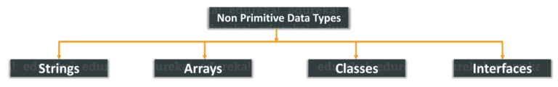
Non primitive data type

Slide 16
non-primitive data types in short.
Classes in Java
These are the special user defined data type. It has member variables and class methods. They are blueprinted by objects.
Java program to illustrate classes:
class DataFlair {
int a, b, c;
void teach() {
System.out.println(“Hi I am teaching at DataFlair”);
}
void learn() {
System.out.println(“Hi I am learning at DataFlair”);.
}
}

Slide 17
Interfaces in Java
These are similar to classes. However there is one prime difference, i,.e the methods are abstract by default. i.e, they have no body.
Similarly, like objects, interfaces are also the blueprints of a class.

Slide 18
If the class implements an interface, then it is supposed to add detail to every function of the interface. If not, then we must declare the class as abstract.
Example program to illustrate interfaces in Java:
interface DataFlair {
void teach();
void learn();
}
class DataFlairCls implements DataFlair {
public void teach() {
System.out.println("I teach at DataFlair");
}
public void learn() {
System.out.println("I learn at DataFlair");
}
public static void main(String[] args) throws IOException {
DataFlairCls ob = new DataFlairCls();
ob.teach();
ob.learn();
}
}

Slide 19
Strings in Java
You may be knowing string as a collection of characters but in Java String is a completely different class altogether. It’s located in java.lang.String. However, strings end with a ‘\0’ character.
Java has a lot of methods for manipulating strings such as substring, length and many more.
Example:
String s=”DataFlair is a fun place to learn”;
String sub=s.substring(0,9);
System.out.println(sub);
Output:
DataFlair

Slide 20
Arrays in Java
Arrays are special memory locations that can store a collection of homogeneous data. They are indexed. Arrays always start indexing from 0. Dynamic allocation of arrays is there in Java. Arrays in Java can be passed as method parameters, local variables and static fields.
Example- int arr[] = new int[100];

Slide 21
Type Casting
The process of converting the value of one data type (int, float, double, etc.) to another data type is known as typecasting.
In Java, there are 13 types of type conversion. However, in this tutorial, we will only focus on the major 2 types.
1. Widening Type Casting
2. Narrowing Type Casting

Slide 22
Widening Type Casting
In Widening Type Casting, Java automatically converts one data type to another data type.
Converting a lower data type into a higher one is called widening type casting. It is also known as implicit conversion or casting down. It is done automatically. It is safe because there is no chance to lose data. It takes place when:

Slide 23
Widening Type Casting
The target type must be larger than the source type.
byte -> short -> char -> int -> long -> float -> double
byte -> short -> char -> int -> long -> float -> double

Slide 24
Narrowing Type Casting
Narrowing Type Casting
Converting a higher data type into a lower one is called narrowing type casting. It is also known as explicit conversion or casting up. It is done manually by the programmer. If we do not perform casting then the compiler reports a compile-time error.
double -> float -> long -> int -> char -> short -> byte

